Slide 1

Top 3 Cryptocurrencies Analysis and Volatility prediction with hybrid LSTM-GARCH model
Zarmina Ursino
zarmina.ursino@studio.unibo.it

Slide 2

Question and Objectives
Research Question
Can an hybrid ANN-GARCH model provide a substantial improvement in predicting the price volatility of the Ethereum? (I chose as ANN, LSTM Model)
Main Objectives
Observe if Bitcoin, Ethereum and Ripple time series are satisfiable for the use of a hybrid model
Implementing a rolling window approach to predict volatility by using the 3 models
“Comparing” the results of the 3 models and highlighting their significances

Slide 3


Methodology
Data Setting
Trends Plot (based on ‘Close’ prices)
Total traded
Candlesticks
Business Understanding
Data Exploration
Dropping NaN rows
Calculation of Volatility
Conclusion
Data
Data Cleaning
Prediction Models
Evaluation
GARCH
LSTM
GARCH+LSTM
- MSE Analysis
- RSME Analysis

Slide 4
Business Understanding
 | BITCOIN | ETHEREUM | RIPPLE
Algorithm | Proof-of-work SHA-256 | Proof-of-work Ethash | Consensus Ripple Protocol Consensus Algorithm
Mining | Yes | Yes | No
Maximum Supply | 21 billion | 18 million per year | 100 billion
Average Trans. Time | 10-minutes | Up to 14-seconds | 4 seconds
Transaction Fee | $40 | $1.13 | $0.004

Slide 5



Data Setting
09 November 2017 - 26 August 2021
1387 Records for each dataset

Slide 6
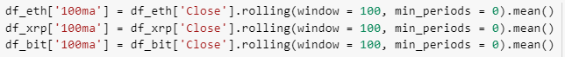
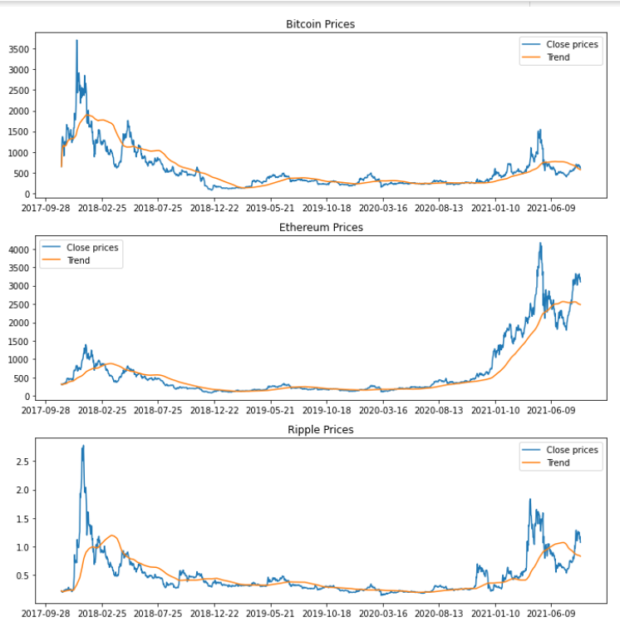
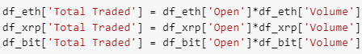
Data Exploration
First, I display the trends of the three cryptocurrencies by scrolling through a window of 100 samples and calculating each time the average price of 'Close’.
Then I calculate the 'Capital Market' by multiplying the Open price with the Volume.

Slide 7
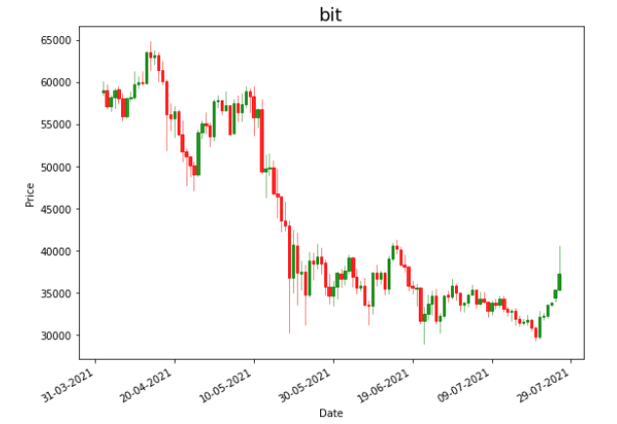
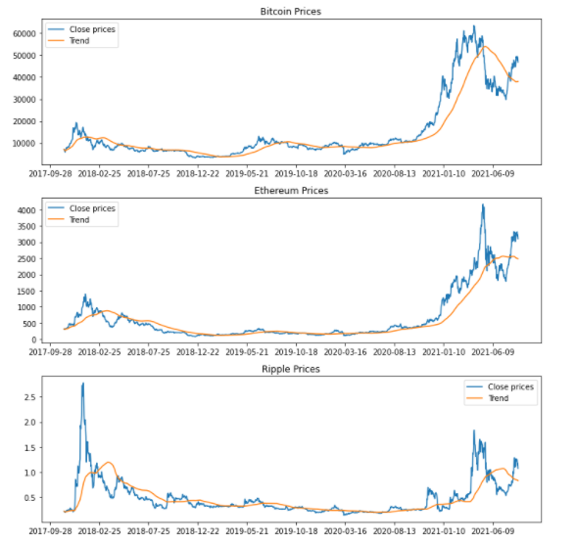
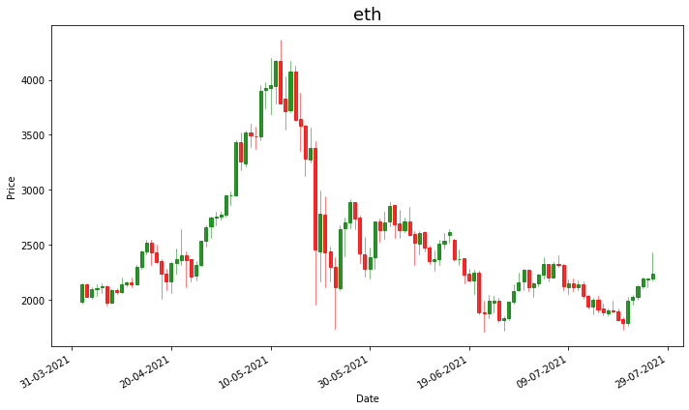
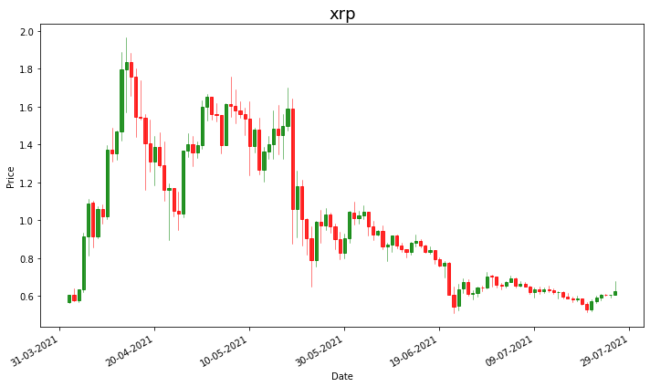
Data Exploration
Maximum of Total traded: 2 September 2020
Maximum of Total traded: 6 May 2021
Maximum of Total traded: 19 May 2021
1 April 2021 to 26 July 2021

Slide 8
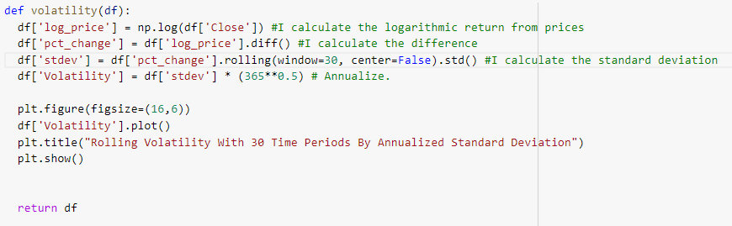

Volatility
Yang Zang estimator is used as it is independent of the jumps and the drifts in the time series and it’s also based on the assumption that the pricing is continuous .
Yang Zang Rolling Volatility with window size = 30 and period = 365
$$σ=\sqrt{\frac{1}{n}\sum_{i=1}^{n}{{\left(x_{i}−\overline{x}\right)}^{2}}}$$

Slide 9

GJR-GARCH Implementation
GJR-GARCH(p,q) model is built where value of p=1 and q=1. Scaled volatility values are then passed through this model for fitting. To generate the rolling forecast volatility, alpha, beta, gamma and omega values obtained from the GJR-GARCH model fitting are required. These values are fetched from the summary of the fitting. Next step in implementation is to solve the GJR-GARCH for each available record and obtain its forecasted volatility based on its t-1 lag value. Thus the GJR-GARCH model is denoted by the formula:
$$σ_{t}^{2}=w+αε_{t−1}^{2}+βσ_{t−1}^{2}+γε_{t−1}^{2}I_{t−1}$$
Where:
$$ε_{t}=σ_{t}z_{t}$$
$$I_{t−1}=O if ε_{t−1}≥0$$
And
$I_{t−1}=1$ if $ε_{t−1}<0$

Slide 10
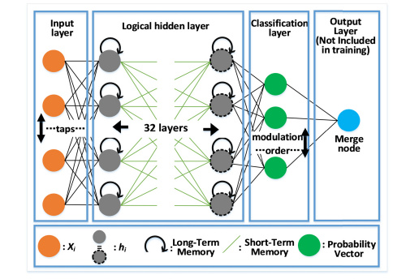
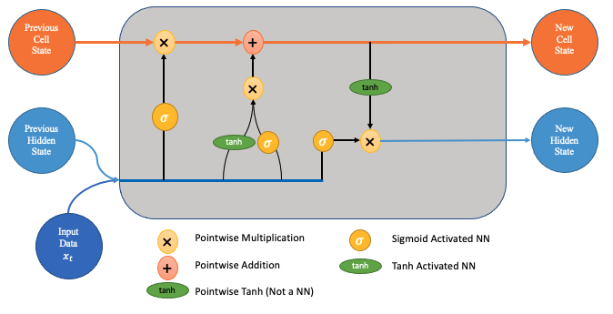
LSTM Implementation
Time-series forecasting models are the models that are capable to predict future values based on previously observed values. Long short-term memory (LSTM) is an artificial recurrent neural network (RNN) architecture used in the field of deep learning. Unlike standard feedforward neural networks, LSTM has feedback connections. It can not only process single data points (e.g. images), but also entire sequences of data (such as speech or video inputs).
Features used for are:
4 layers, 10 nodes per layer and 0.1 dropout for each layer to regularize.
5th layer was the output layer with 1 node
RNN regressor of TensorFlow is used for implementation with 20 epochs and 32 batch size. For dataset of 1421 records, 20 epochs seemed to be optimum based on trial and error
This project is using ”Adam” optimizer for stochastic gradient descent thus optimizing ”mean squared error” as a loss function. Adam optimizer will change the weights of the nodes every iteration for the training dataset, making it much robust.

Slide 11
Hybrid Model Implementation
To reduce the error in the GJR-GARCH model forecasting, its forecasted volatility is fed to the LSTM model along with the normal volatility as a input. Hence the model have 2 input layers and 1 output layer while keeping rest of the parameters same.Addition on one more input node to the LSTM makes a model complexity higher.
Crypto prices
Garch (1, 1)
LSTM Architecture
Output

Slide 12
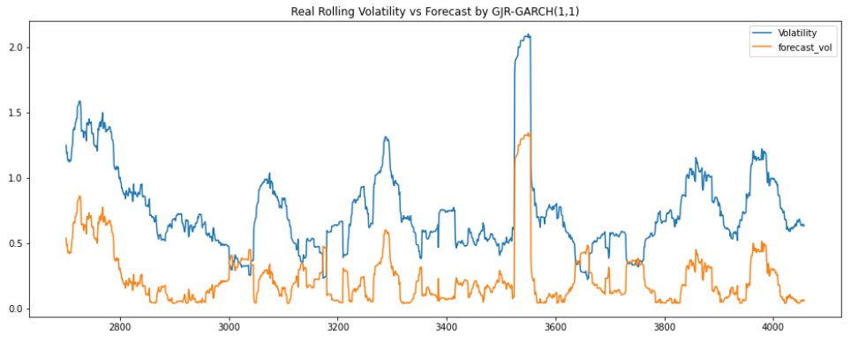
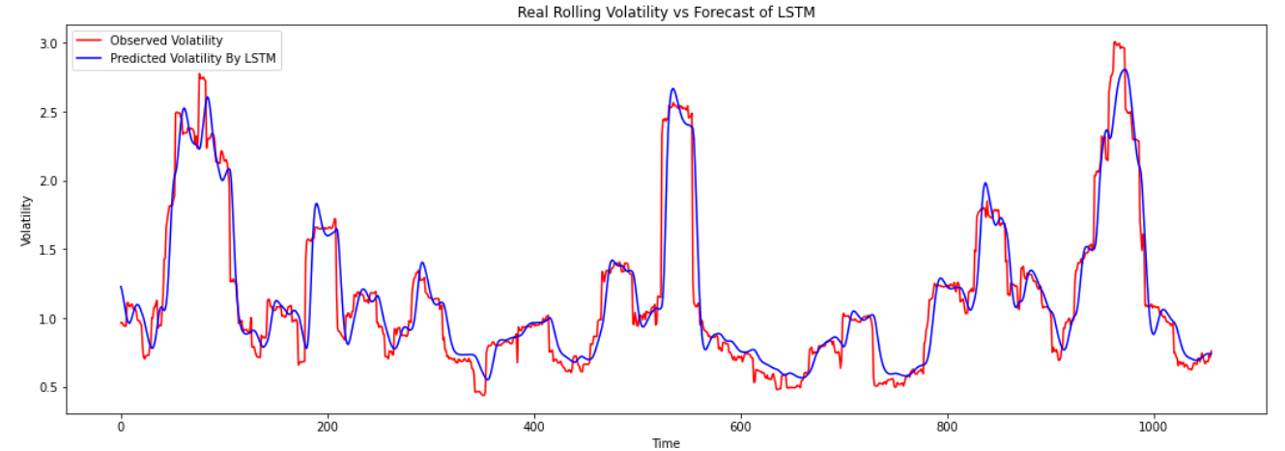
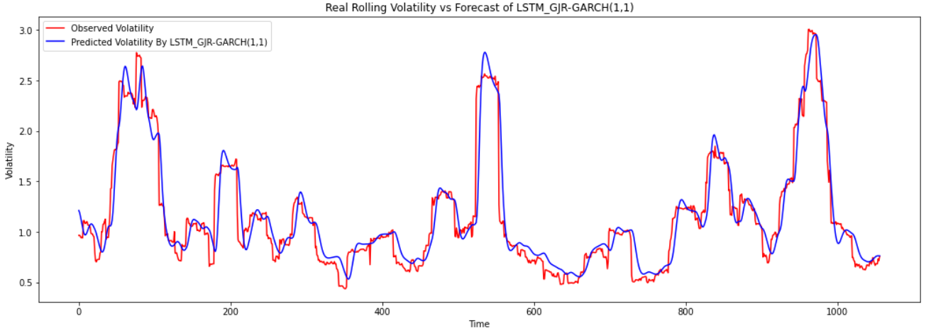
Bitcoin Results

Slide 13

Evaluation for Bitcoin
Epoch 1/20 34/34 [==============================] - 22s 426ms/step - loss: 0.7704
Epoch 2/20 34/34 [==============================] - 15s 431ms/step - loss: 0.2376
Epoch 3/20 34/34 [==============================] - 15s 430ms/step - loss: 0.1757
Epoch 4/20 34/34 [==============================] - 14s 423ms/step - loss: 0.1540
Epoch 5/20 34/34 [==============================] - 15s 428ms/step - loss: 0.1316
Epoch 6/20 34/34 [==============================] - 14s 423ms/step - loss: 0.1130
Epoch 7/20 34/34 [==============================] - 15s 429ms/step - loss: 0.0965
Epoch 8/20 34/34 [==============================] - 15s 429ms/step - loss: 0.0899
Epoch 9/20 34/34 [==============================] - 15s 427ms/step - loss: 0.0860
Epoch 10/20 34/34 [==============================] - 15s 431ms/step - loss: 0.0920
Epoch 11/20 34/34 [==============================] - 14s 422ms/step - loss: 0.0841
Epoch 12/20 34/34 [==============================] - 14s 421ms/step - loss: 0.0780
Epoch 13/20 34/34 [==============================] - 14s 425ms/step - loss: 0.0774
Epoch 14/20 34/34 [==============================] - 15s 435ms/step - loss: 0.0653
Epoch 15/20 34/34 [==============================] - 15s 426ms/step - loss: 0.0678
Epoch 16/20 34/34 [==============================] - 14s 426ms/step - loss: 0.0634
Epoch 17/20 34/34 [==============================] - 14s 423ms/step - loss: 0.0715
Epoch 18/20 34/34 [==============================] - 14s 423ms/step - loss: 0.0613
Epoch 19/20 34/34 [==============================] - 15s 427ms/step - loss: 0.0597
Epoch 20/20 34/34 [==============================] - 14s 414ms/step - loss: 0.0618
Model | MSE | RSME | Percentage change
GRR_GARCH(1, 1) | 0.29409822617 | 0.5423051010434152 | --
LSTM | 0.625735252554 | 0.7810342929066005 | 0.96%
GRJ-GARCH + LSTM | 0,619530544102 | 0.7871026261560092 | 0.776%
$$\%Change=(1−\frac{New RMSE}{Old RMSE} )×100$$

Slide 14
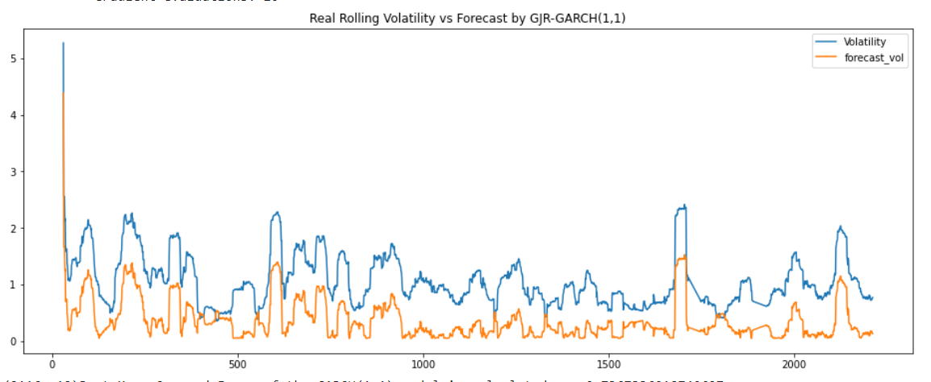
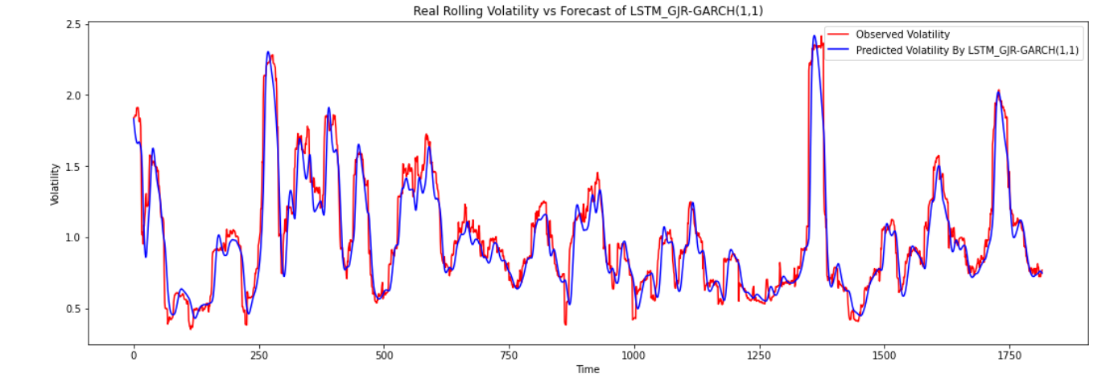
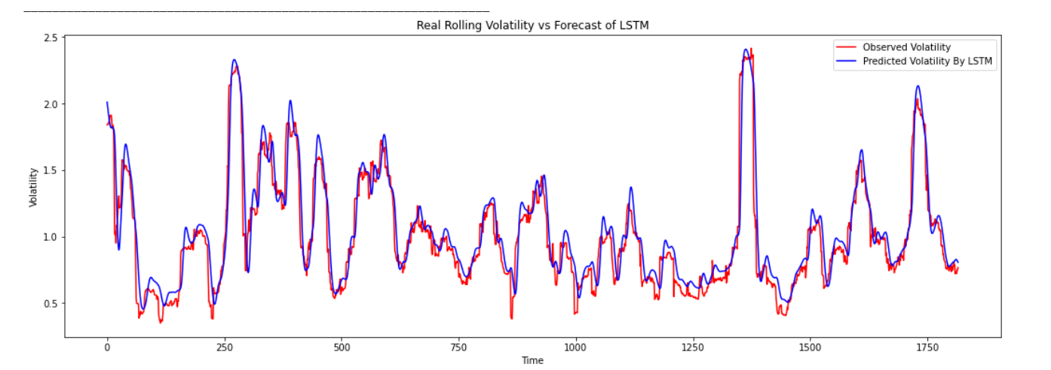
Ethereum Results

Slide 15
Evaluation for Ethereum
Epoch 1/20 31/31 [==============================] - 21s 432ms/step - loss: 0.5833
Epoch 2/20 31/31 [==============================] - 13s 435ms/step - loss: 0.1631
Epoch 3/20 31/31 [==============================] - 13s 430ms/step - loss: 0.1518
Epoch 4/20 31/31 [==============================] - 14s 441ms/step - loss: 0.1143
Epoch 5/20 31/31 [==============================] - 13s 436ms/step - loss: 0.0891
Epoch 6/20 31/31 [==============================] - 13s 434ms/step - loss: 0.0807
Epoch 7/20 31/31 [==============================] - 13s 430ms/step - loss: 0.0769
Epoch 8/20 31/31 [==============================] - 13s 424ms/step - loss: 0.0548
Epoch 9/20 31/31 [==============================] - 13s 427ms/step - loss: 0.0537
Epoch 10/20 31/31 [==============================] - 13s 430ms/step - loss: 0.0504
Epoch 11/20 31/31 [==============================] - 13s 418ms/step - loss: 0.0539
Epoch 12/20 31/31 [==============================] - 13s 424ms/step - loss: 0.0466
Epoch 13/20 31/31 [==============================] - 13s 425ms/step - loss: 0.0420
Epoch 14/20 31/31 [==============================] - 13s 422ms/step - loss: 0.0418
Epoch 15/20 31/31 [==============================] - 13s 426ms/step - loss: 0.0457
Epoch 16/20 31/31 [==============================] - 13s 423ms/step - loss: 0.0416
Epoch 17/20 31/31 [==============================] - 13s 428ms/step - loss: 0.0368
Epoch 18/20 31/31 [==============================] - 13s 428ms/step - loss: 0.0408
Epoch 19/20 31/31 [==============================] - 13s 429ms/step - loss: 0.0394
Epoch 20/20 31/31 [==============================] - 13s 431ms/step - loss: 0.0376
Model | MSE | RSME | Percentage change
GRR_GARCH(1, 1) | 0,485989456 | 0.6971294396705378 | --
LSTM | 0, 336398643782 | 0.5799988308452648 | 27%
GRJ-GARCH + LSTM | 0,313922063036 | 0.5602874824910546 | 3, 4%

Slide 16
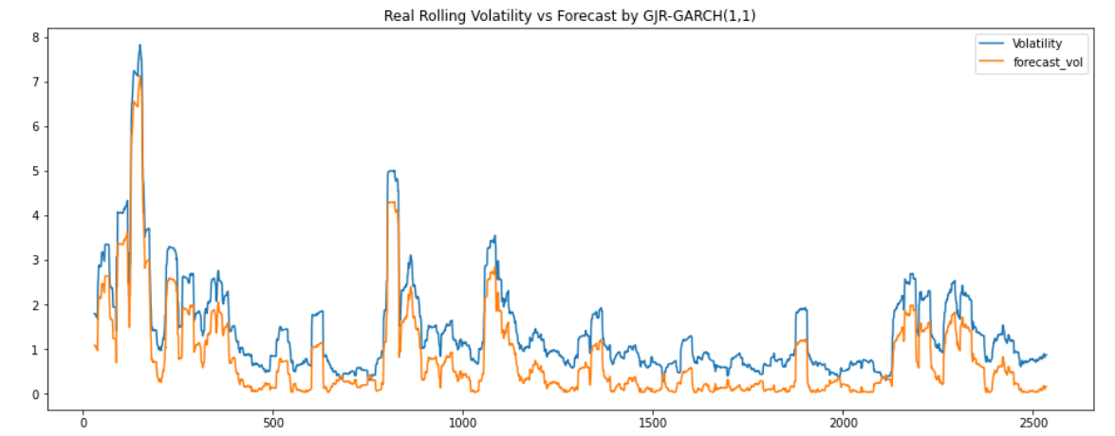
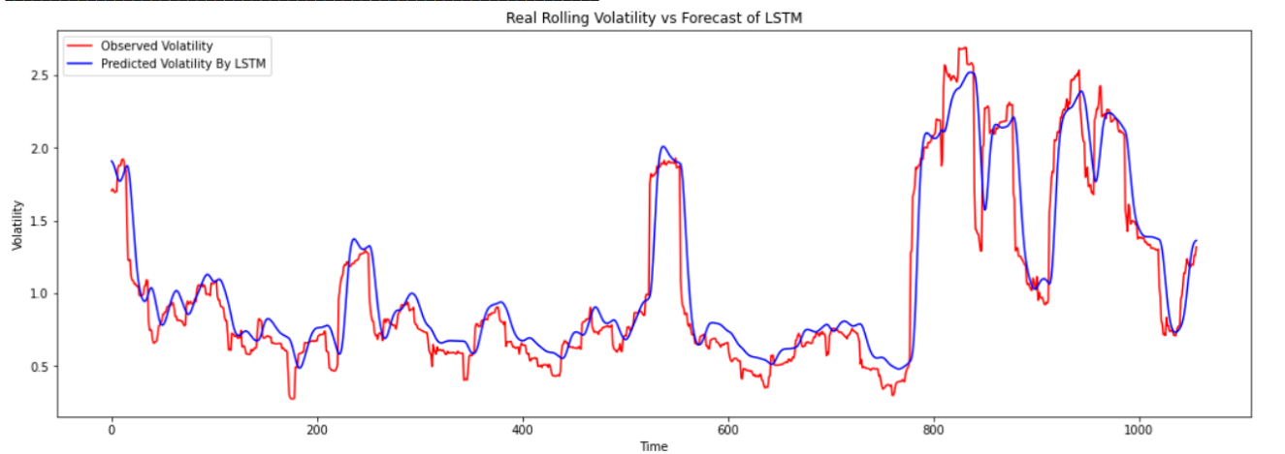
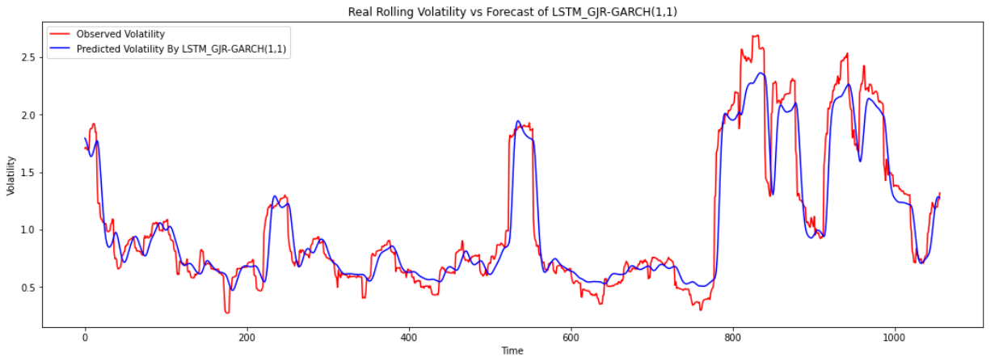
Ripple Results

Slide 17
Evaluation for Ripple
Epoch 1/20 34/34 [==============================] - 22s 423ms/step - loss: 0.6675
Epoch 2/20 34/34 [==============================] - 15s 427ms/step - loss: 0.2512
Epoch 3/20 34/34 [==============================] - 15s 429ms/step - loss: 0.1418
Epoch 4/20 34/34 [==============================] - 14s 419ms/step - loss: 0.1150
Epoch 5/20 34/34 [==============================] - 14s 420ms/step - loss: 0.1127
Epoch 6/20 34/34 [==============================] - 14s 421ms/step - loss: 0.1039
Epoch 7/20 34/34 [==============================] - 14s 424ms/step - loss: 0.0924
Epoch 8/20 34/34 [==============================] - 14s 424ms/step - loss: 0.0856
Epoch 9/20 34/34 [==============================] - 14s 422ms/step - loss: 0.0935
Epoch 10/20 34/34 [==============================] - 14s 425ms/step - loss: 0.0802
Epoch 11/20 34/34 [==============================] - 15s 427ms/step - loss: 0.0836
Epoch 12/20 34/34 [==============================] - 14s 420ms/step - loss: 0.0842
Epoch 13/20 34/34 [==============================] - 15s 427ms/step - loss: 0.0758
Epoch 14/20 34/34 [==============================] - 14s 420ms/step - loss: 0.0787
Epoch 15/20 34/34 [==============================] - 14s 426ms/step - loss: 0.0644
Epoch 16/20 34/34 [==============================] - 15s 428ms/step - loss: 0.0681
Epoch 17/20 34/34 [==============================] - 14s 421ms/step - loss: 0.0666
Epoch 18/20 34/34 [==============================] - 14s 422ms/step - loss: 0.0640
Epoch 19/20 34/34 [==============================] - 14s 425ms/step - loss: 0.0669
Epoch 20/20 34/34 [==============================] - 14s 422ms/step - loss: 0.0648
Model | MSE | RSME | Percentage change
GRR_GARCH(1, 1) | 0,387136875 | 0.6222032424652556 | --
LSTM | 0.682060640232 | 0.8258696266553099 | -28.74%
GRJ-GARCH + LSTM | 0.64806269814 | 0.8050234146532611 | 2.52%

Slide 18

Conclusion
The results obtained suggested that the hybrid model has the least error thus implying it is better suited hence answering the research question if a hybrid model of ANN-GARCH can provide significant improvement in predicting the price volatility with an answer as yes
Objectives | Achieved or not?
Observe if Bitcoin, Ethereum and Ripple time series are satisfiable for the use of a hybrid model
Implementing a rolling window approach to predict volatility by using 3 models: GARCH, LSTM, GARCH+LSTM
Comparison of the 3 models and highlighting their importance
The limitation of this research is, it only consists of the historical data, but totally ignores external factors affecting the pricing and volatility such as news outbreak, change in governance, imposition of new rules, etc. It may really be interesting to see the results of sentiment analysis on such new and volatile asset class. This research can be revisited once there is adequate amount of data available for the training of heavy models like LSTM. Until then, this research can be used as a base for developing new hybrid models and testing their volatility.

Slide 19
Thank you for your attention!

Slide 20
References
Datasets Source Link
How to read candlesticks? Link
Asset Returns Link
MAE, MSE, RMSE, Coefficient of Determination, Adjusted R Squared — Which Metric is Better? Link
From the book “Blockchain 2021”, Nathan Real
GARCH Modelling of Cryptocurrencies, Link

